Slide 2
FIT 152 Fundamentals of Information Technology
Lecture 1
Information Technology

Slide 3
FIT 152: Module outcomes
Upon successful completion of this course, the student will be able to:
Demonstrate an understanding of the relationship between IT and related and informing disciplines.
Demonstrate insight in the history of computing technology, and an understanding of the Internet, and the World-Wide Web, as well as the components of an IT system and how they interrelate.
Demonstrate an understanding of complexity in an information technology environment and how and why it occurs.
Demonstrate an understanding of why life-long learning and continued professional development is critical for an IT professional.
Illustrate the use of information and communication technologies to solve problems.
Demonstrate an understanding of how and to what extent IT has changed various application domains.

Slide 4
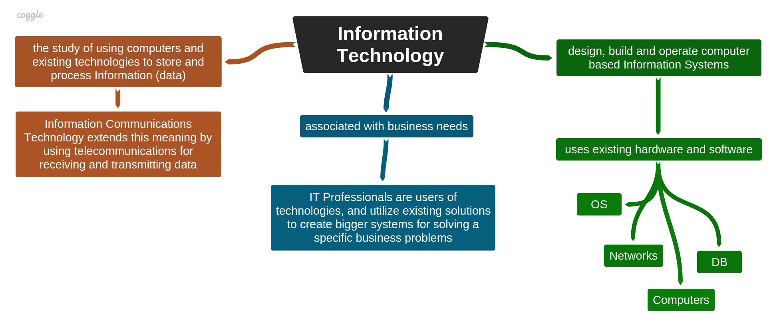
What is Information Technology?

